Slide 1
Lecture 1 What is Data Communication, Computer Networking, History, Properties
Spring 2022

Slide 2
Data communication refers to the exchange of data between a source and a receiver via form of transmission media such as a wire cable.
Computer networking may be considered a branch of electrical engineering, telecommunications, computer science, information technology or computer engineering, since it relies upon the theoretical and practical application of the related disciplines.

Slide 3
Computer network or data network
It is a telecommunications network that allows computers to exchange data.
In computer networks, networked computing devices pass data to each other along data connections.
The connections (network links) between nodes are established using either cable media or wireless media.
The best-known computer network is the Internet.

Slide 4
Network computer devices that originate, route and terminate the data are called network nodes.
Nodes can include hosts such as personal computers, phones, servers as well as networking hardware.
Two such devices are said to be networked together when one device is able to exchange information with the other device, whether or not they have a direct connection to each other.

Slide 5
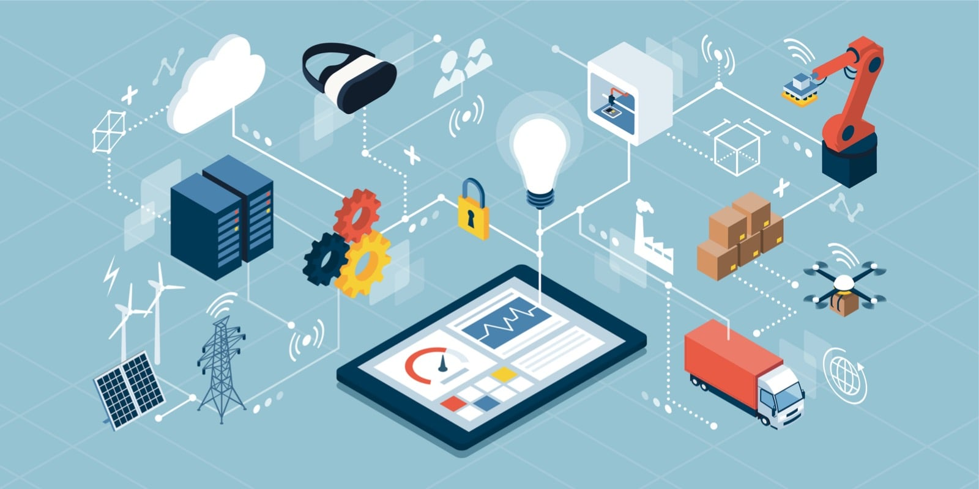

Slide 6
Computer networks support applications such as access to the World Wide Web, shared use of application and storage servers, printers, and fax machines, and use of email and instant messaging applications.
Computer networks differ in the physical media used to transmit their signals, the communications protocols to organize network traffic, the network's size, topology and organizational intent.

Slide 7
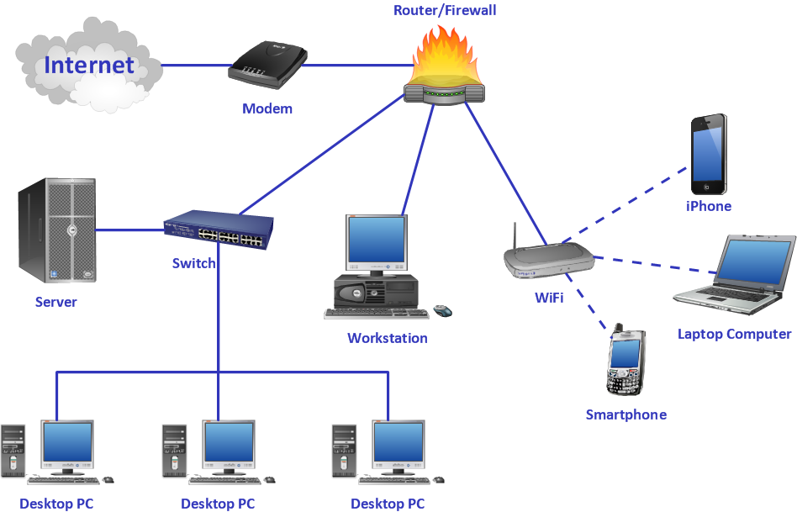
Networking

Slide 8
History
In the late 1950s, early networks of communicating computers included the military radar system Semi-Automatic Ground Environment (SAGE).
In 1960, the commercial airline reservation system semi-automatic business research environment (SABRE) went online with two connected mainframes.
In 1962, J.C.R. Licklider developed a working group he called the "Intergalactic Computer Network", a precursor to the ARPANET, at the Advanced Research Projects Agency (ARPA).

Slide 9
In 1964, researchers at Dartmouth developed the Dartmouth Time Sharing System for distributed users of large computer systems.
The same year, at Massachusetts Institute of Technology, a research group supported by General Electric and Bell Labs used a computer to route and manage telephone connections.

Slide 10
Throughout the 1960s, Leonard Kleinrock, Paul Baran, and Donald Davies independently developed network systems that used packets to transfer information between computers over a network.
In 1965, Thomas Marill and Lawrence G. Roberts created the first wide area network (WAN). This was an immediate precursor to the ARPANET, of which Roberts became program manager.

Slide 11
Also in 1965, the first widely used telephone switch that implemented true computer control was introduced by Western Electric.
In 1969, the University of California at Los Angeles, the Stanford Research Institute, the University of California at Santa Barbara, and the University of Utah were connected as the beginning of the ARPANET network using 50 kbit/s circuits.

Slide 12
In 1976, John Murphy of Datapoint Corporation created ARCNET, a token-passing network first used to share storage devices.
In 1995, the transmission speed capacity for Ethernet was increased from 10 Mbit/s to 100 Mbit/s.
By 1998, Ethernet supported transmission speeds of a Gigabit. The ability of Ethernet to scale easily (such as quickly adapting to support new fiber optic cable speeds) is a contributing factor to its continued use today.

Slide 13
Today, computer networks are the core of modern communication.
All modern aspects of the public switched telephone network (PSTN) are computer-controlled.
To days boom in communications would not have been possible without the progressively advancing computer network.
Computer networks, and the technologies that make communication between networked computers possible, continue to drive computer hardware, software, and peripherals industries. The expansion of related industries is mirrored by growth in the numbers and types of people using networks, from the researcher to the home user.

Slide 14
A computer network has the following properties:
Facilitates interpersonal communications:
People can communicate efficiently and easily via email, instant messaging, chat rooms, telephone, video telephone calls, and video conferencing.

Slide 15
Allows sharing of files, data, and other types of information:
Authorized users may access information stored on other computers on the network. Providing access to information on shared storage devices is an important feature of many networks.

Slide 16
Allows sharing of network and computing resources
Users may access and use resources provided by devices on the network, such as printing a document on a shared network printer. Distributed computing uses computing resources across a network to accomplish tasks..

Slide 17
May be insecure
A computer network may be used by computer Crackers to deploy computer viruses or computer worms on devices connected to the network, or to prevent these devices from accessing the network (denial of service).

Slide 18
May be difficult to set up
A complex computer network may be difficult to set up. It may be costly to set up an effective computer network in a large organization

